Slide 1
Pocket Legal
Milton Garcia and Kojiro So

Slide 2
The Problem
Legal questions are often defined by a jurisdiction (local, state, federal) and law practice among many other things; it’s often the who or where that creates confusion, and by the time you solve that problem, you mostly forgot your initial legal question. Especially if this is your first time navigating the legal system.

Slide 3
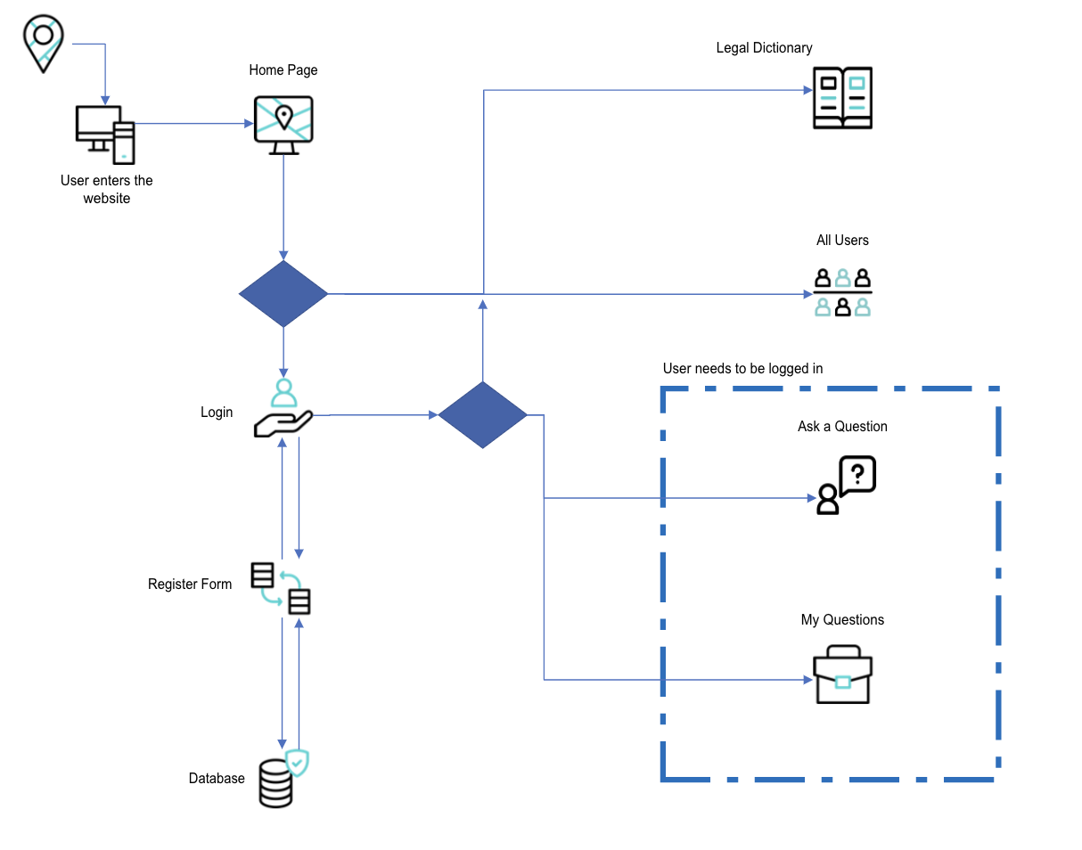
Our Solution
Notes:
Pocket Legal is a web application that allows users to access open access legal information that can be used for education, research, and civic personal use.
PL helps create a bridge for non-legal audiences connect to legal resources and tools to help understand the law, its language, and a structure that affects everyone daily.
The following MERN, web app product features, allows users through one concise data form, to document and cast a question. And like a bulletin board, offer others users to crowdsource an answer (a feature the we would like to implement in the future).

